Slide 1
Limits on Parallel Performance
It would appear that the parallel time can be made arbitrarily small by making the decomposition finer in granularity.
There is an inherent bound on how fine the granularity of a computation can be. For example, in the case of multiplying a dense matrix with a vector, there can be no more than (n²) concurrent tasks.
Concurrent tasks may also have to exchange data with other tasks. This results in communication overhead. The tradeoff between the granularity of a decomposition and associated overheads often determines performance bounds.

Slide 2
Task Interaction Graphs
Subtasks generally exchange data with others in a decomposition. For example, even in the trivial decomposition of the dense matrix-vector product, if the vector is not replicated across all tasks, they will have to communicate elements of the vector.
The graph of tasks (nodes) and their interactions/data exchange (edges) is referred to as a task interaction graph.
Note that task interaction graphs represent data dependencies, whereas task dependency graphs represent control dependencies.
Notes:
The pattern of interaction among tasks is captured by what is known as a task-interaction graph. The nodes in a task-interaction graph represent tasks and the edges connect tasks that interact with each other. The nodes and edges of a task-interaction graph can be assigned weights proportional to the amount of computation a task performs and the amount of interaction that occurs along an edge, if this information is known. The edges in a task interaction graph are usually undirected, but directed edges can be used to indicate the direction of flow of data, if it is unidirectional. The edge-set of a task-interaction graph is usually a superset of the edge-set of the task-dependency graph. In the database query example discussed earlier, the task-interaction graph is the same as the task-dependency graph.
We now give an example of a more interesting task-interaction graph that results from the problem of sparse matrix-vector multiplication.

Slide 3
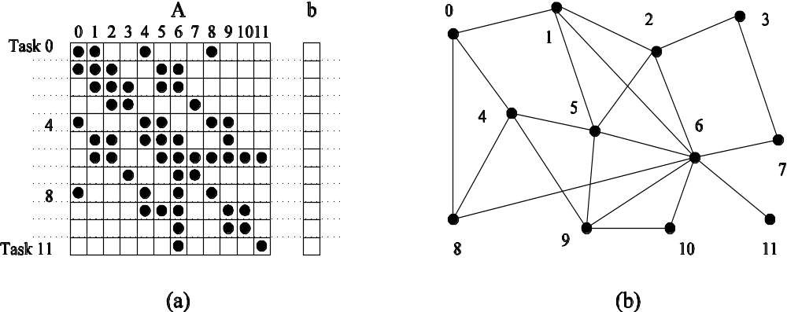
Task Interaction Graphs: An Example
Consider the problem of multiplying a sparse matrix A with a vector b. The following observations can be made:
As before, the computation of each element of the result vector can be viewed as an independent task.
Unlike a dense matrix-vector product though, only non-zero elements of matrix A participate in the computation.
If, for memory optimality, we also partition b across tasks, then one can see that the task interaction graph of the computation is identical to the graph of the matrix A (the graph for which A represents the adjacency structure).

Slide 4
Task Interaction Graphs, Granularity, and Communication
In general, if the granularity of a decomposition is finer, the associated overhead (as a ratio of useful work assocaited with a task) increases.
Example: Consider the sparse matrix-vector product example from previous foil. Assume that each node takes unit time to process and each interaction (edge) causes an overhead of a unit time.
Viewing node 0 as an independent task involves a useful computation of one time unit and overhead (communication) of three time units.
Now, if we consider nodes 0, 4, and 5 as one task, then the task has useful computation totaling to three time units and communication corresponding to four time units (four edges). Clearly, this is a more favorable ratio than the former case.

Slide 5
Processes and Mapping
In general, the number of tasks in a decomposition exceeds the number of processing elements available.
For this reason, a parallel algorithm must also provide a mapping of tasks to processes.
Note: We refer to the mapping as being from tasks to processes, as opposed to processors. This is because typical programming APIs, as we shall see, do not allow easy binding of tasks to physical processors. Rather, we aggregate tasks into processes and rely on the system to map these processes to physical processors. We use processes, not in the UNIX sense of a process, rather, simply as a collection of tasks and associated data.

Slide 6
Processes and Mapping
Appropriate mapping of tasks to processes is critical to the parallel performance of an algorithm.
Mappings are determined by both the task dependency and task interaction graphs.
Task dependency graphs can be used to ensure that work is equally spread across all processes at any point (minimum idling and optimal load balance).
Task interaction graphs can be used to make sure that processes need minimum interaction with other processes (minimum communication).

Slide 7
Processes and Mapping
An appropriate mapping must minimize parallel execution time by:
Mapping independent tasks to different processes.
Assigning tasks on critical path to processes as soon as they become available.
Minimizing interaction between processes by mapping tasks with dense interactions to the same process.
Note: These criteria often conflict eith each other. For example, a decomposition into one task (or no decomposition at all) minimizes interaction but does not result in a speedup at all! Can you think of other such conflicting cases?

Slide 8
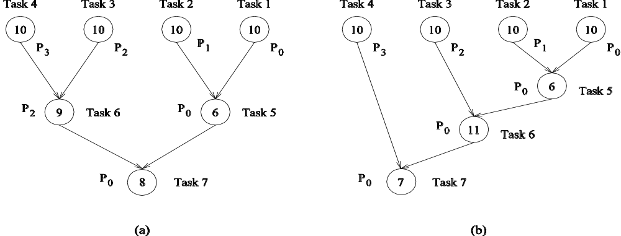
Processes and Mapping: Example
Mapping tasks in the database query decomposition to processes. These mappings were arrived at by viewing the dependency graph in terms of levels (no two nodes in a level have dependencies). Tasks within a single level are then assigned to different processes.

